Slide 1
Microsoft Power Platform + Dynamics 365
Notes:
Hi, Welcome to Microsoft Power Platform + Dynamics 365 Bootcamp.

Slide 2
Day 1: Power Packed Day with Power Canvas Apps - Part 2

Slide 3

Agenda
Introduction to PowerApps
Benefits of PowerApps
What can I build with PowerApps?
Types of PowerApps
Canvas Apps
Data Sources and Connectors
Demo
Create the records in Dynamics CRM with the blank canvas app using Patch function

Slide 4
Benefits of low-code app development
Focus on innovating. We take care of the rest.
Increased development agility
Automate and enhance repetitive and time-consuming processes and reduce errors across your organization.
Speed & savings
Reduce time & cost building web and mobile applications, enabling you to get through your development backlog.
Efficiency
Effortless Dynamics 365, Office 365, and Azure integration. Remove your data siloes through low-code with Common Data Service and AI Builder.
Gartner estimates that 65% of all app dev will be low code by 2024

Slide 5

Turn great ideas into apps
IT is an expert in security, governance, compliance, integrations & scalability.
Low code empowers this partnership to
unlock innovation
across organizations.
Business is an expert at solving business problems.

Slide 6

Take advantage of the opportunities together
65%
App Development Backlog
65% of organizations report an app development backlog.
37%
Paper processes
37% of organizations are still using paper to manage critical business processes
69%
Accelerate digital innovation and transformation
69% of organizations say that accelerating digital innovation & transformation is the number 1 reason they embraced low code application development
Forrester, Q1 Digital Process Automation Survey (for process improvement efforts 2 years from now); Dresner Advisory Services, The State of Business Intelligence, 2018 (critical responses only)​
Notes:
25% of professional developers have already embraced low code application development to automate repetitive aspects of the dev ops life cycle.
500 million applications will be developed in the next 5 years.

Slide 7
Power Apps provides quantitative benefits for your organization compared to traditional development
70%
Less application development cost & effort
362%
Return on investment over 3-year term

Slide 8
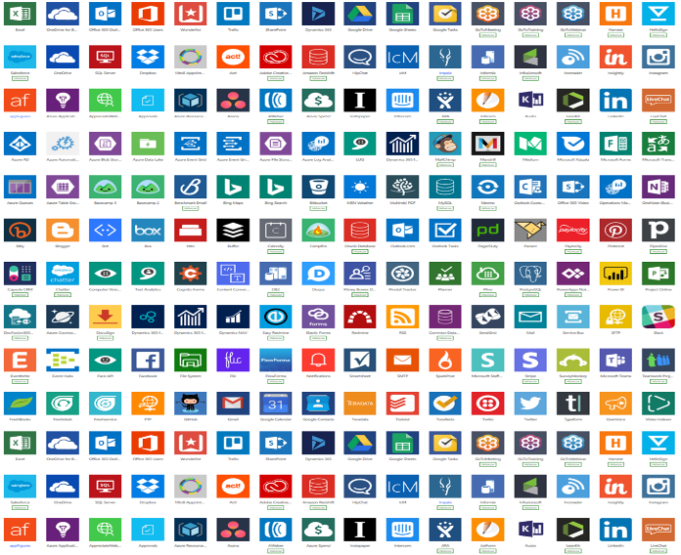
Low code in digital transformation
Some processes are best solved by off-the-shelf SaaS solutions.
But there isn’t always “an app for that.”
Some processes are best be solved by custom app development.
But there is only so much custom app development an organization can invest in.
Everything else is a missed opportunity to optimize and innovate. Low-code development solves this for you.

Slide 9
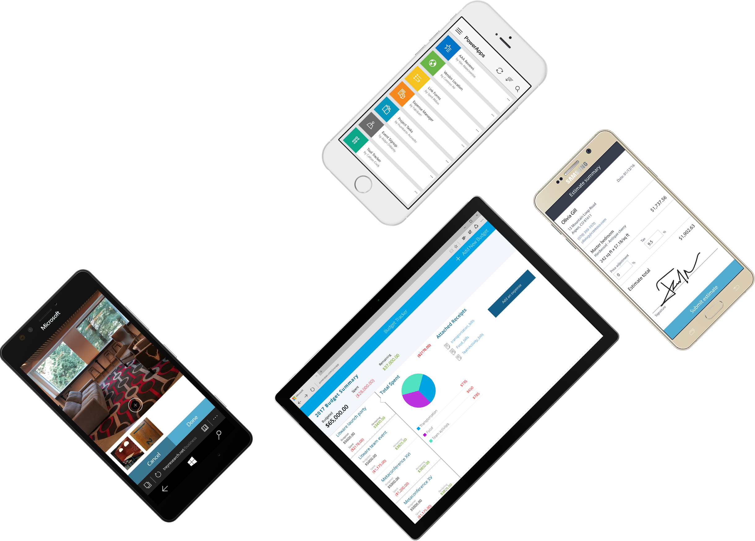
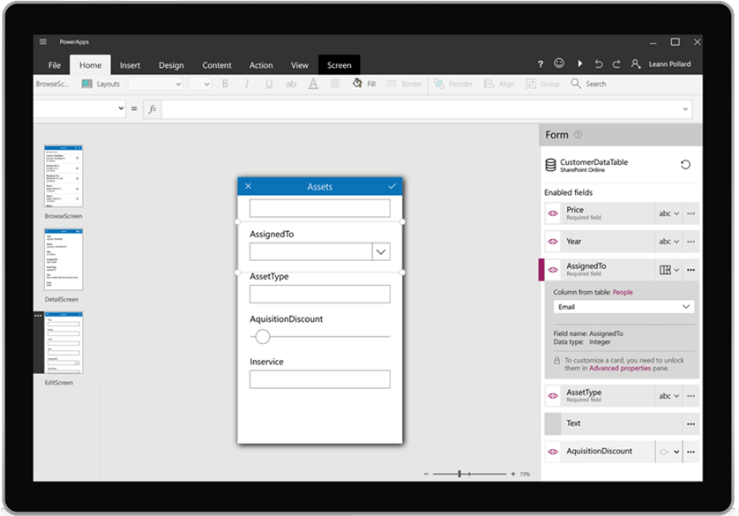






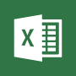







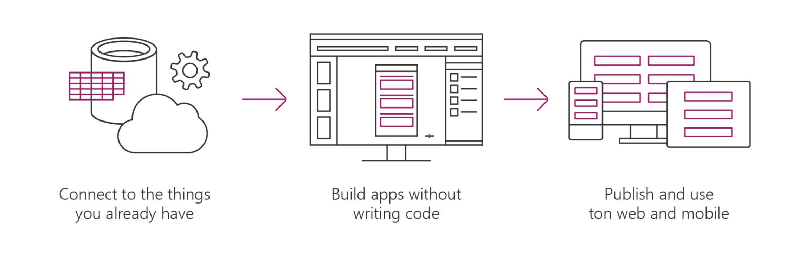
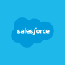



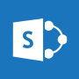






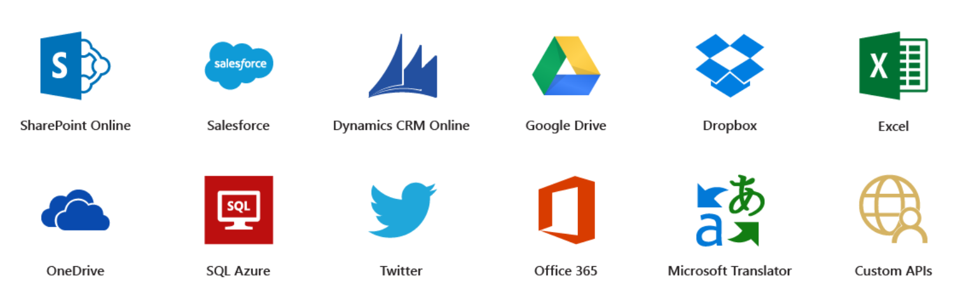




Microsoft PowerApps
Connect to existing systems and data sources
Common Data Platform
Azure Functions & REST services
Build apps, forms, and workflows without writing code
Publish apps instantly for web and mobile
Notes:
Microsoft PowerApps is a service for creating and using custom business apps across platforms

Slide 10
Benefits of PowerApps
Secure Scalable Managed Integrated Compliant
Fast Iterative
Cross-platform
Beautiful Easy

Slide 11
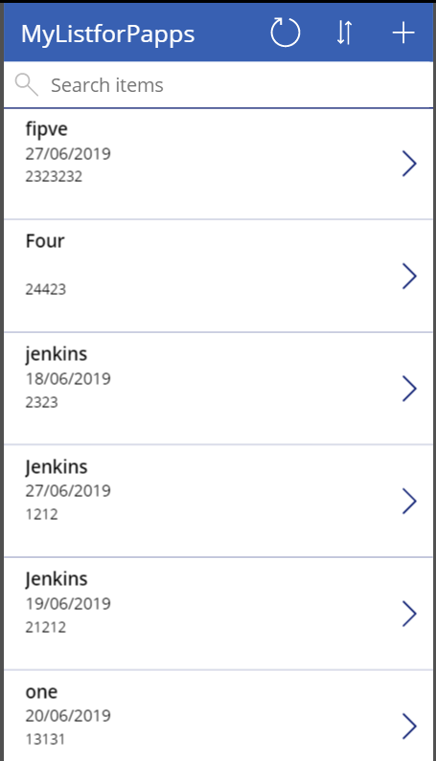
What can I build with PowerApps?
Apps based on data (SharePoint*, SQL, but also DropBox and Google Drive)
Onedimensional, form-based apps
Simple, single-task apps
Microphone, camera, GPS coordinates. Ink and pen support.
Multiple data sources in one app
Multiple screens

Slide 12
86% of the Fortune 500 are using Power Apps

Slide 13
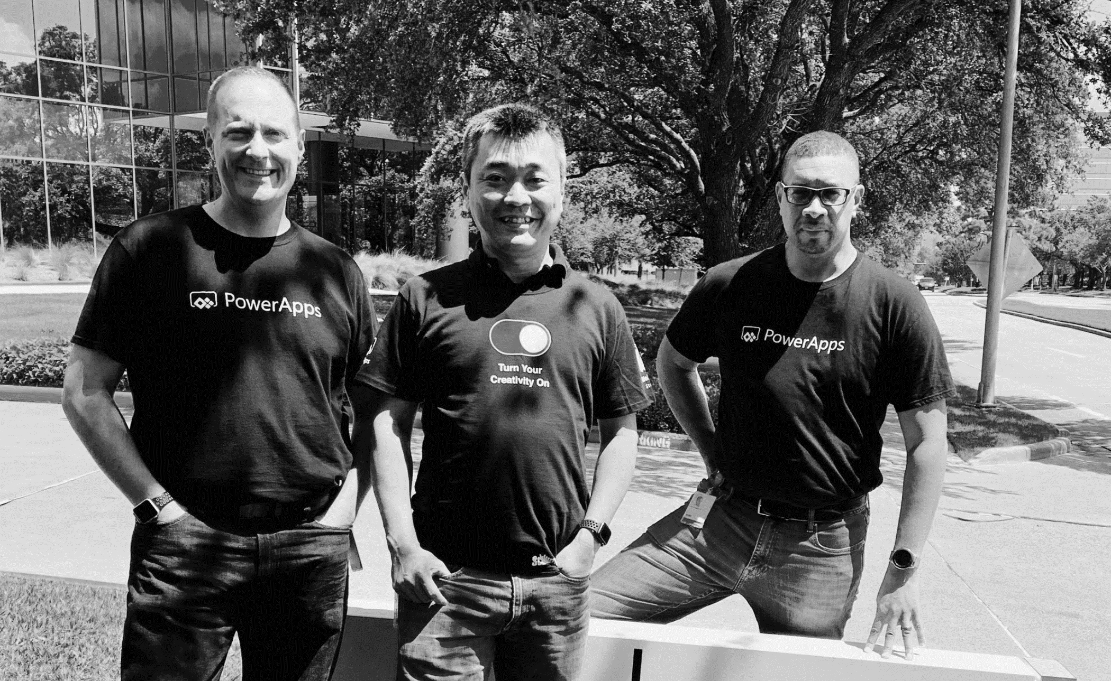
Pro dev
Citizen dev
IT admin
Empower every developer to do more.

Slide 14
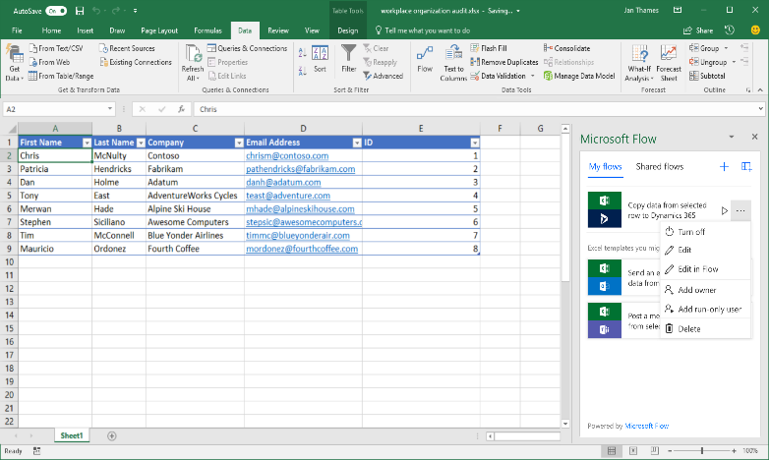
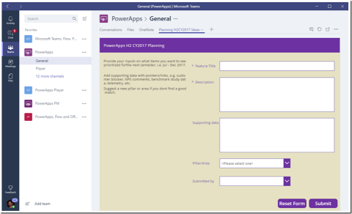
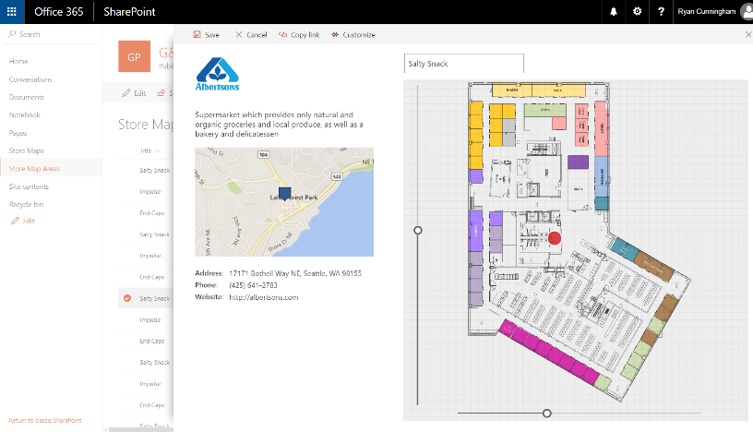
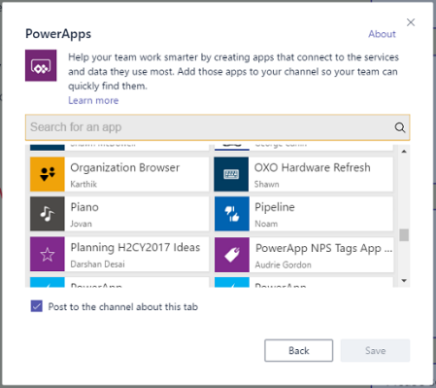
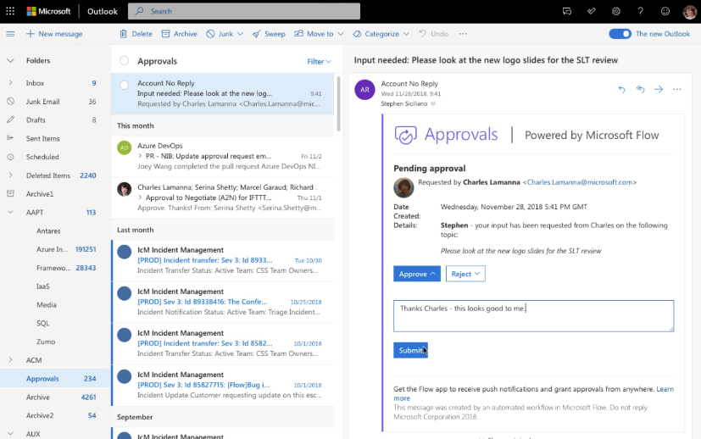
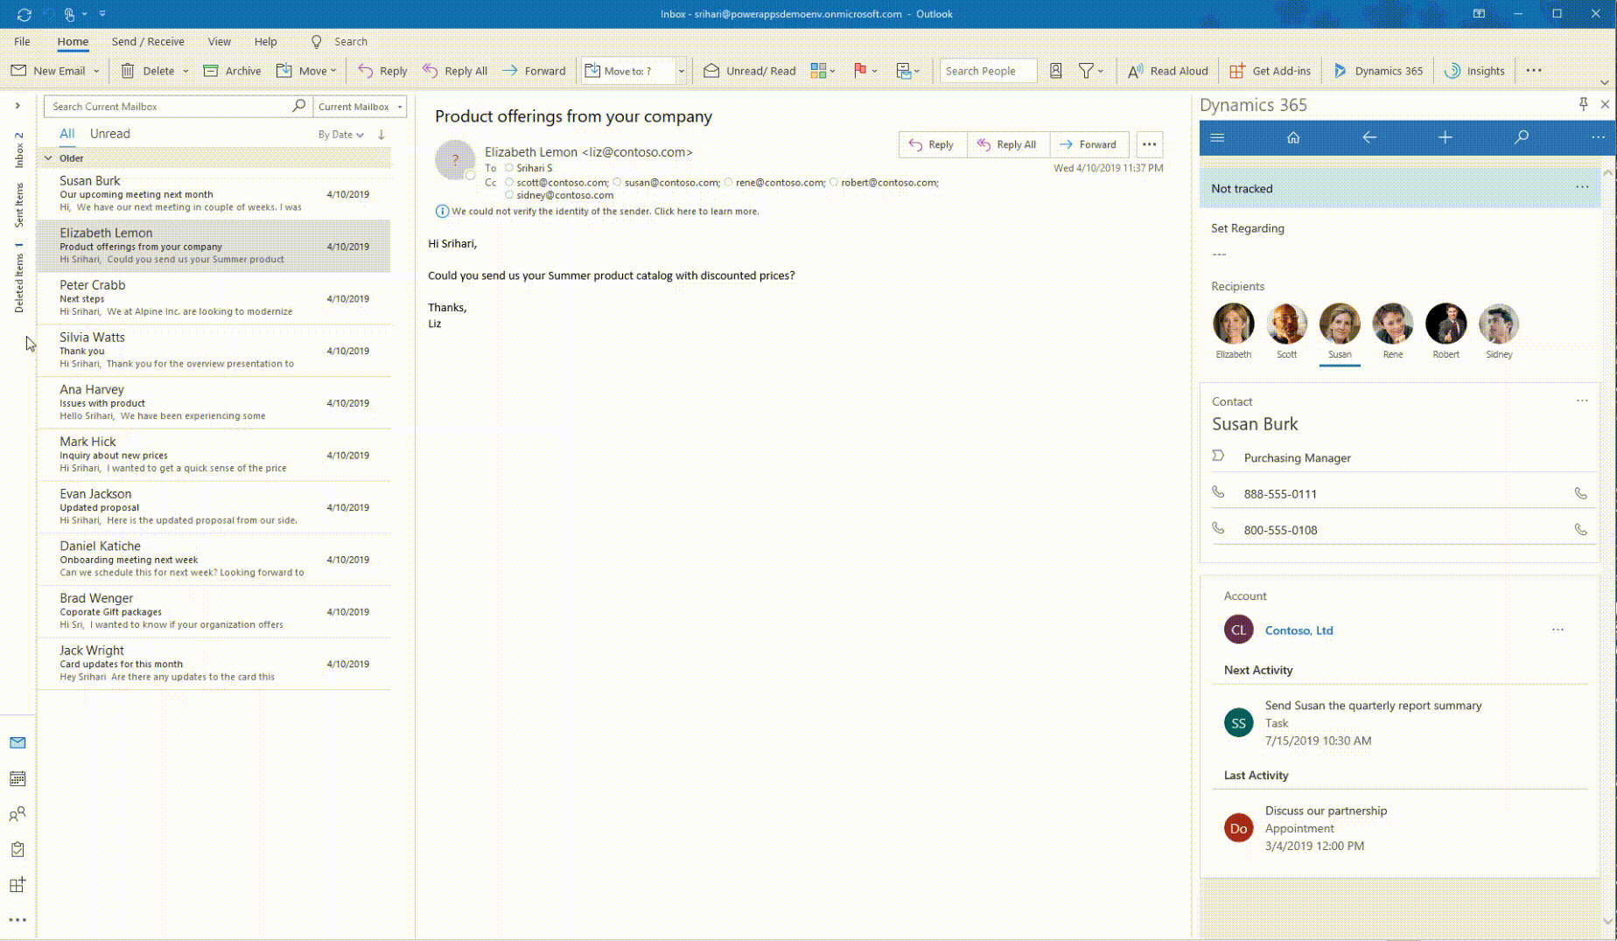
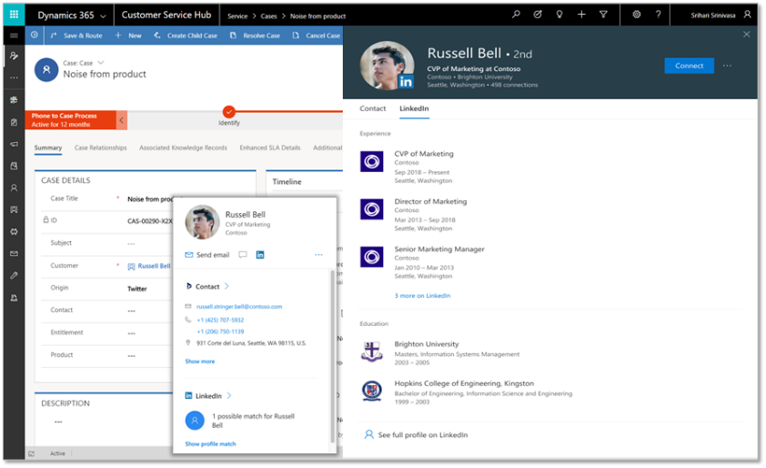
Deeply integrated with Microsoft 365
Customize the experience and automate SharePoint Lists with PowerApps and Flow
Build a PowerApp app from an Excel sheet or automate on an Excel sheet with Flow
Customize a tab with PowerApps, or automate a bot or process with Flow
Enhanced communication with Actionable Messages and Adaptive cards in Flow
Bring data from CDS and PowerApps UX to Outlook with the Mail App (WIn32, OWA and mobile)
Office 365 People Card in PowerApps + Dynamics (incl. LinkedIn info)

Slide 15

Why did we go with PowerApps
We needed a digital onboarding experience with a clear path for customers to follow in self-service planning of their Dynamics 365
Traditional web portals and custom apps are of course great if you know exactly what that path should look like
What we needed the most was the ability to experiment with the elements that should/shouldn’t be included in the onboarding path
Low-code/no-code approach of PowerApps canvas apps significantly lowers our need to commit to any specific feature or idea
Ability to delay developing any tailored UI or integration running on custom code, to the point when you know what you want to automate

Slide 16

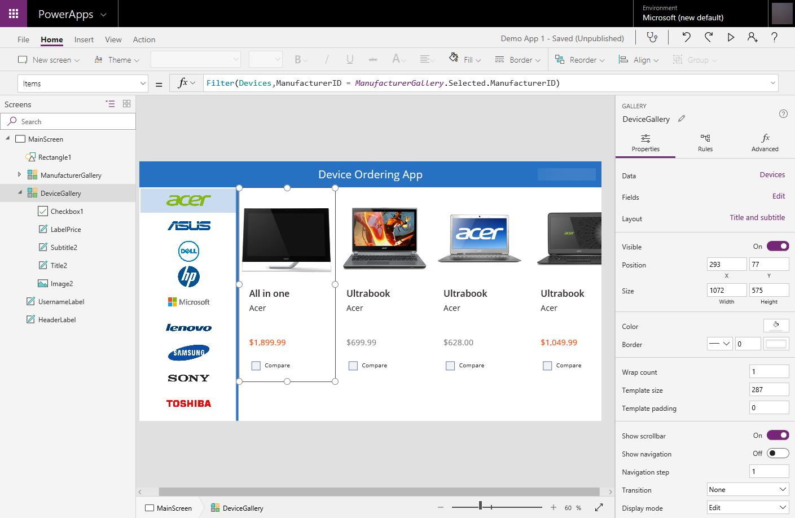

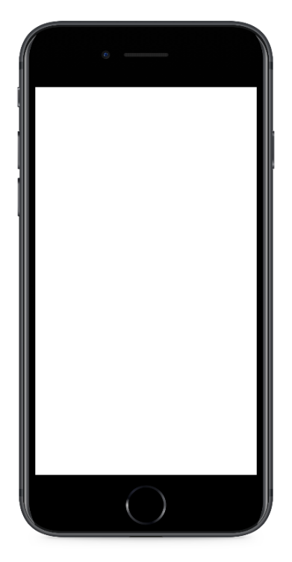
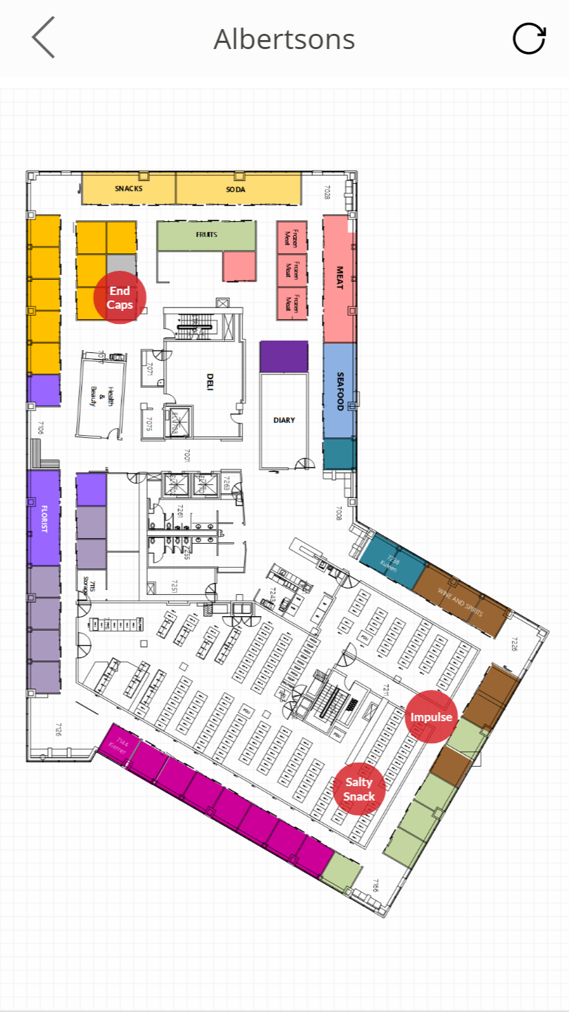
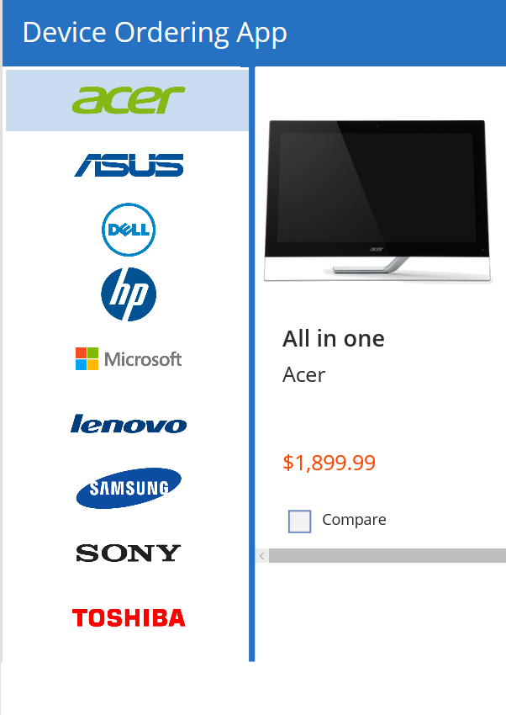
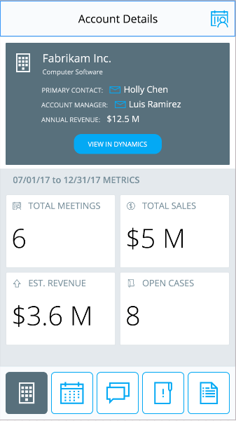

Power Apps: a low-code approach to building apps
Easily build apps with a full featured low-code / no-code platform
Connect to your existing data with 250+ pre-built connectors and custom connectors
Store your data in the Common Data Service
Integrated with Office 365, Azure, Dynamics 365, and Power BI
Strong enterprise governance & security
Pro-dev extensibility

Slide 17

Power Platform
Power Automate
PowerApps
Power BI
Also known as “Business Applications Platform” or “BAP”
Create business processes
Build apps easily & speedily
Gain global insights instantly

Slide 18
Power Platform
Common Data Services
Enables data from multiple data sources works together
Power Automate
PowerApps
Power BI
Connectors, Gateways, APIs
250+ built-in and custom connectors
Seamless connectivity to On-Prem systems or cloud services
Foundational Services
Pro Developer Extensibility
Empowers the pro developer with more sophisticated developer capabilities
Connectors and Gateways
Common Data Service
Pro dev extensibility

Slide 19
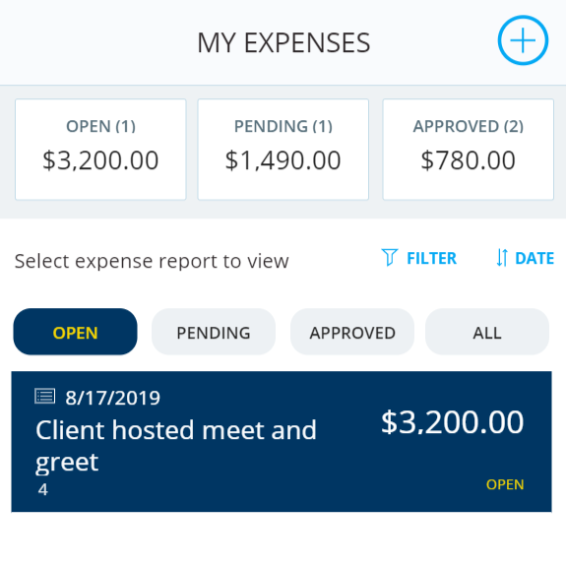
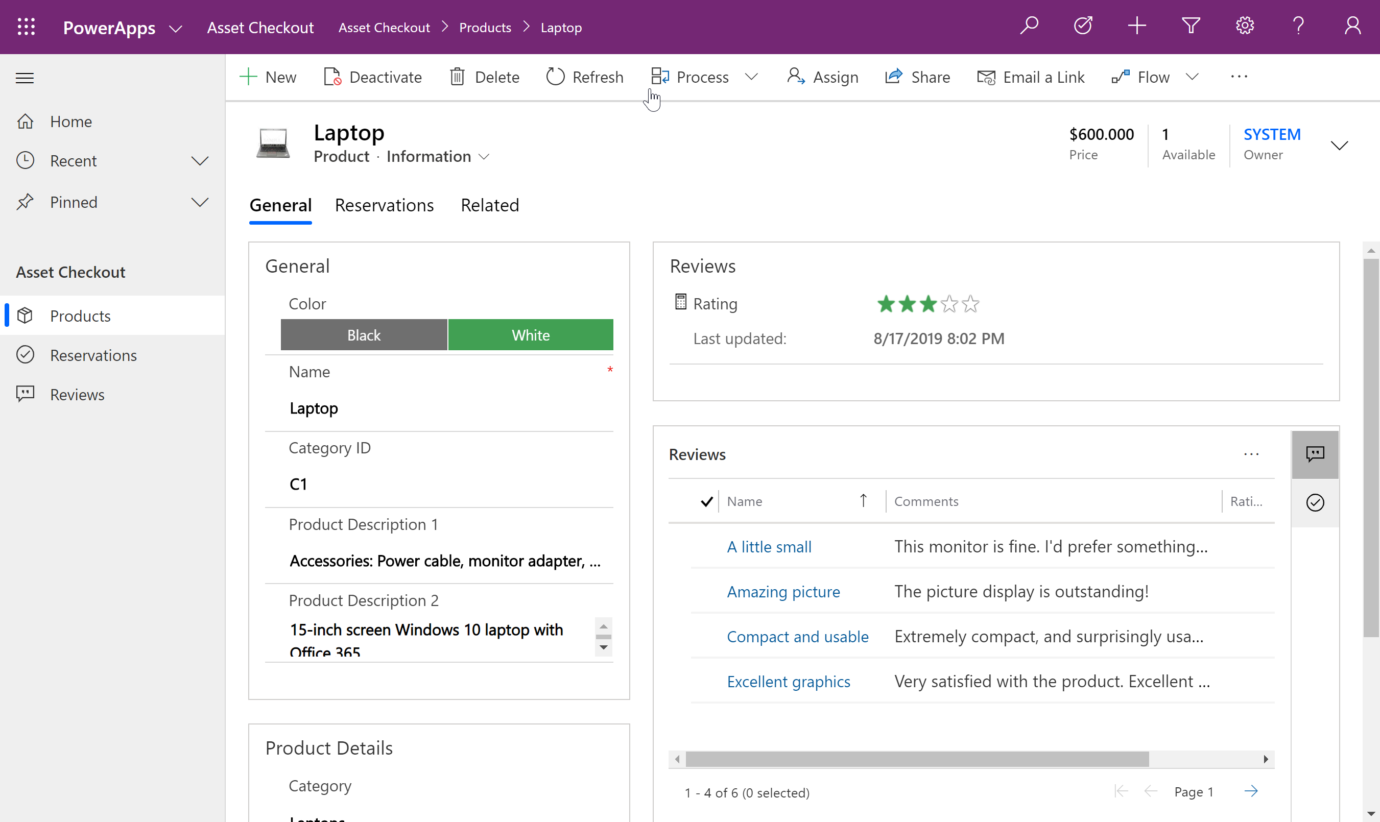
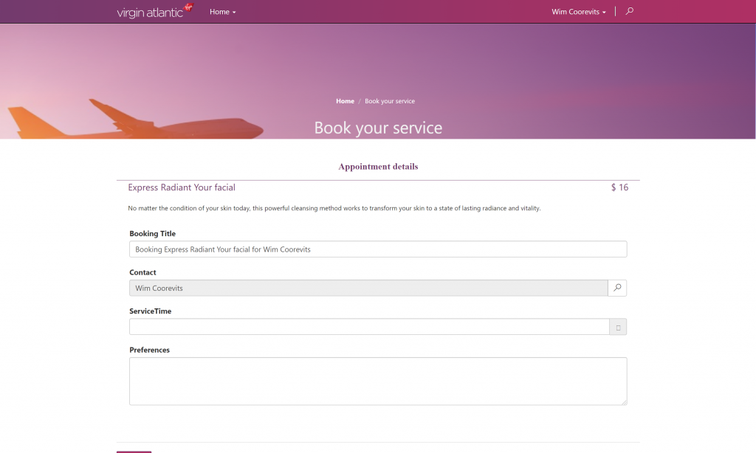
Types of Power Apps
Canvas Apps
Model Driven Apps
Portals

Slide 20

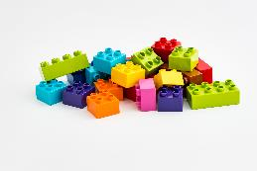
Power Platform
Create reusable components & services
Build enterprise applications
PowerApps
Model-Driven Apps
Build model-driven & canvas apps
Extend model-driven components or apps by creating different UX
Create easy task-based apps
Canvas Apps

Slide 21
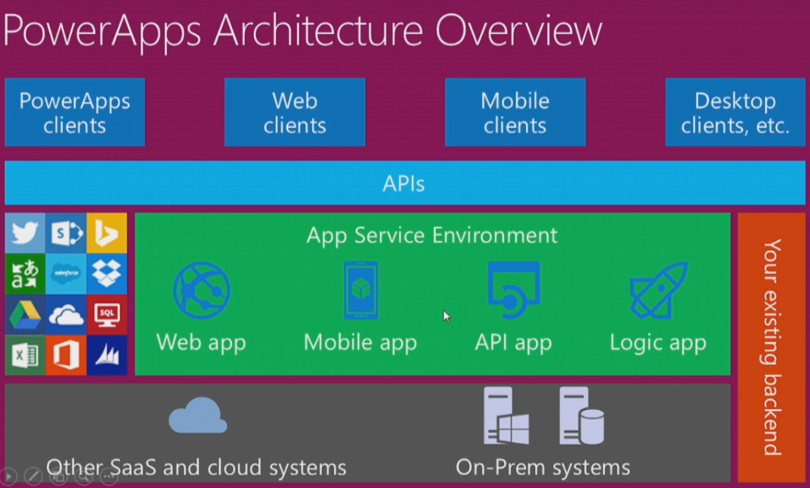

Slide 22

Canvas Apps

Slide 23

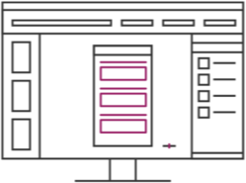
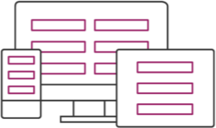
Canvas Apps help business-power-users to create and use custom business apps across platforms using Excel and PowerPoint skills
Connect to data & systems you’re already using easily
Create apps, forms, and workflows without writing code
Use apps on any device – both web and mobile

Slide 24
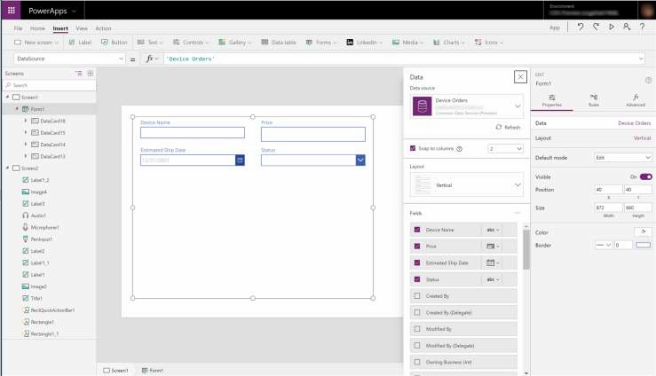
EASY AUTHORING
Truly WYSIWYG – full control over user experience, use it as you build it
Create app logic with familiar Excel-like expressions
Mash up data from multiple
sources right at the app level

Slide 25
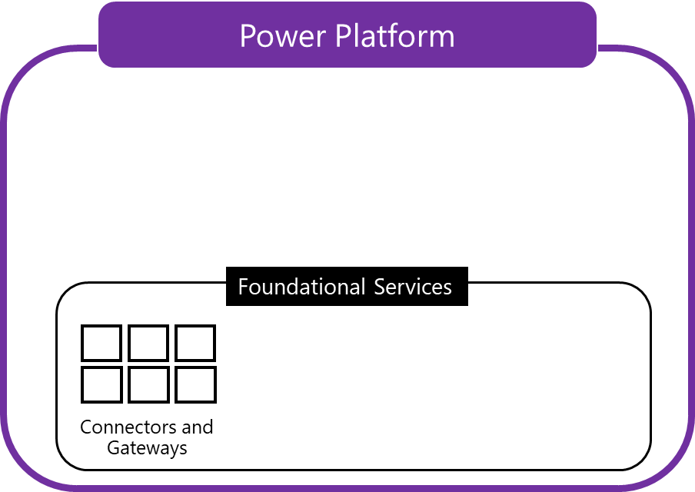
Built-in connectivity to 200+ cloud services, files, databases, web APIs, etc.
Seamless hybrid connectivity to on- premises systems via the On- Premises Data Gateway
Build custom connectors for everyone to leverage

Slide 26
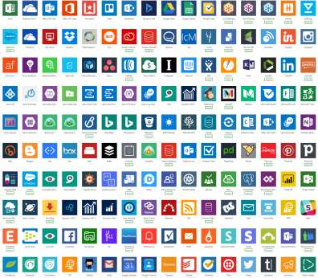
CLOUD AND ON-PREMISES CONNECTIVITY
Built-in connectivity to 200+ cloud services, files, databases, web APIs, etc.
Seamless hybrid connectivity to on- premises systems via the On- Premises Data Gateway
Build custom connectors for everyone to leverage

Slide 27
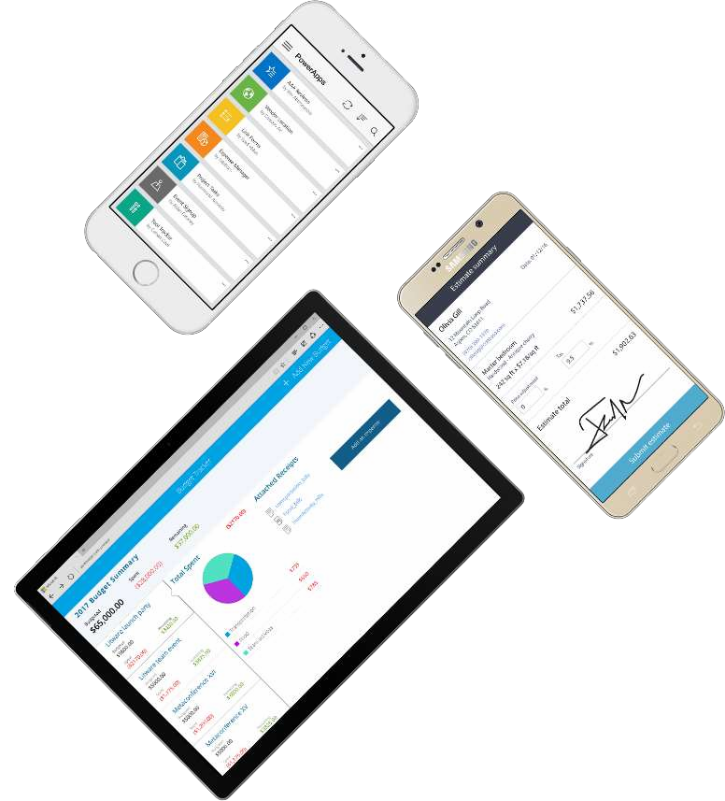
CROSS-PLATFORM
Publish instantly to iOS, Android,
Windows, and the web
Sharing apps is like sharing documents
Manage across environments

Slide 28

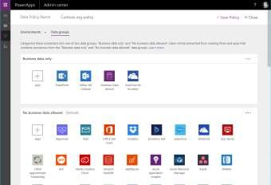
ENTERPRISE-GRADE MANAGEMENT AND CONTROL
All identity is managed through Azure Active Directory, enabling rich policies and multi- factor authentication
Admin Center providing full audit logs, usage analytics, data loss prevention, security and data management
Centrally manage all your apps, first and third party, deployed across your organization

Slide 29
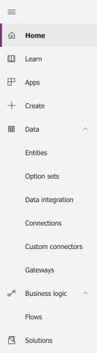
POWERAPPS MAKER PORTAL [HTTPS://WEB.POWERAPPS.COM/]
Home page for Makers
Learn
Guided learning, documentation, community, what’s new
Apps
View apps, open apps, create new apps, run sample apps, create apps from sample apps
Create
Create new apps from blank or from sample apps
Data
Manage Entities, option sets, data integration, connections, custom connections & gateways
Business Logic
Add Flows to your apps
Solutions
Create packages of PowerApps, Flows and CDS Entities (Solutions), distribute them to your customers or move them across environments

Slide 30
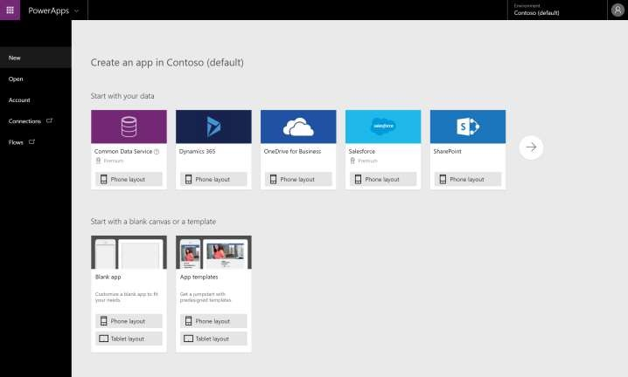
POWERAPPS STUDIO FOR THE WEB [HTTPS://CREATE.POWERAPPS.COM/]
Canvas apps authoring experience
Start with your data
Start with a blank canvas
Start with a template

Slide 31
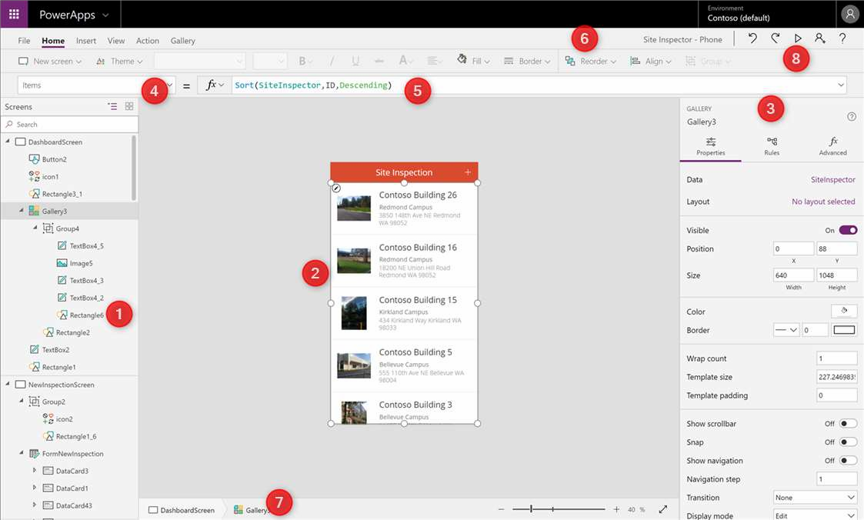
POWERAPPS STUDIO PARTS
Left Navigation bar
Middle pane (current screen)
Right hand pane
Property Pane
Formula bar
Ribbon
Bread crumb navigation
Preview button (F5)

Slide 32

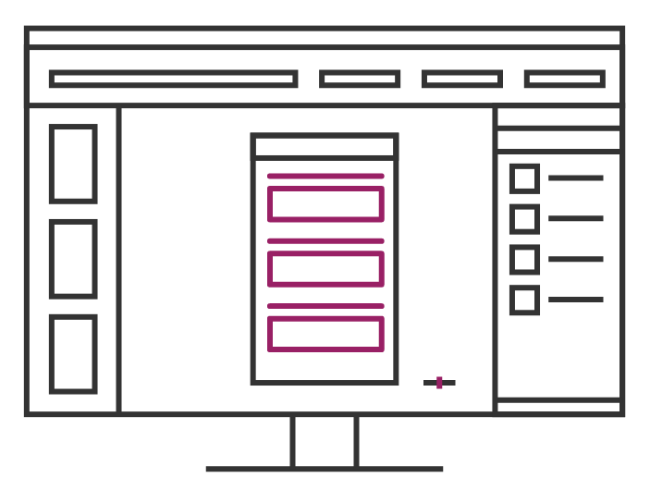
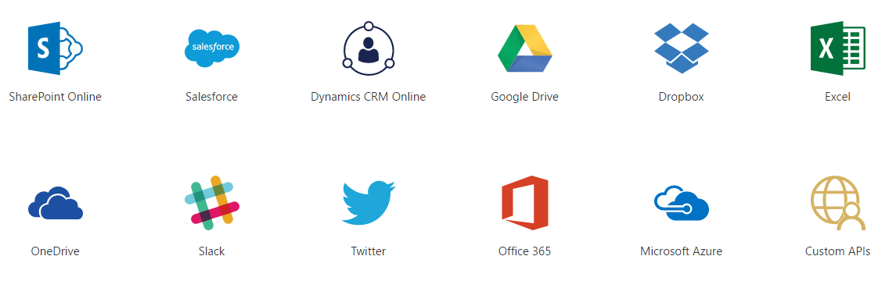
Data Sources and connections

Slide 33
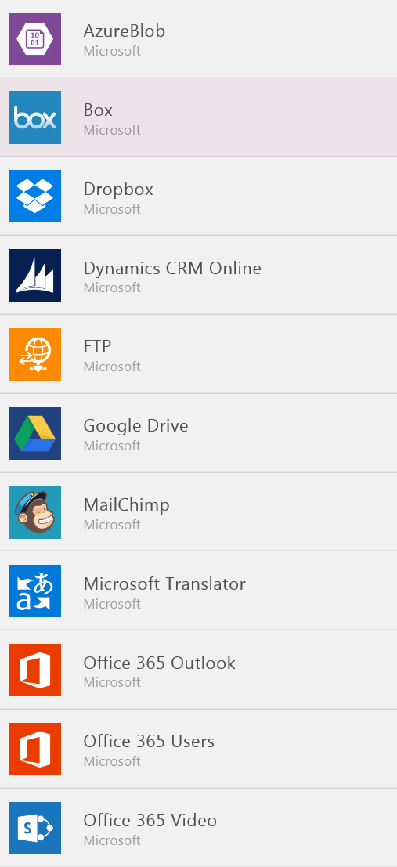
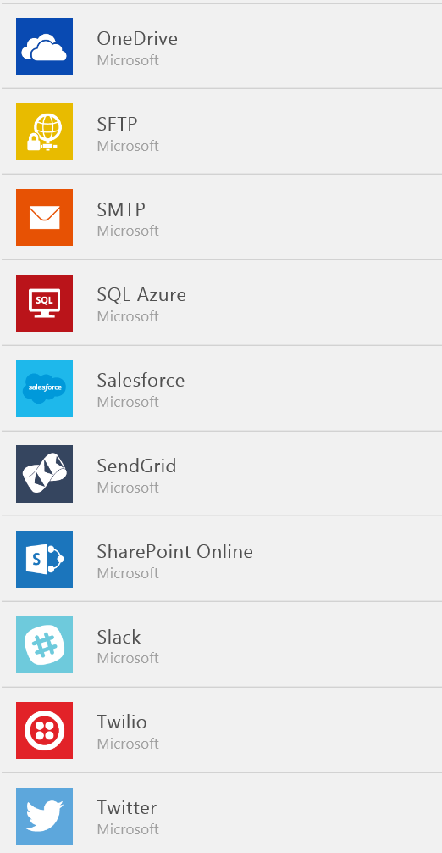
Data Sources…
SaaS Data Sources
Excel on OneDrive
Excel on Dropbox
Excel on Google Drive
Office 365
SharePoint Online Lists
Google Sheets
Sales force
Dynamics CRM

Slide 34
Branding and Media
Linking control properties
Backgrounds
Colors and transparency
Duplicating screens
Copying the look and feel
Using images
Embed and play audio and video

Slide 35
PowerApps Controls
Labels
Buttons
Text inputs
Controls
Galleries
Data tables
Forms
Media
Charts
Icons

Slide 36
Formulas, Variables & Collections
Understand & implement variables
Using functions
Understand & implement collections
Notes:
https://docs.microsoft.com/en-us/powerapps/maker/canvas-apps/working-with-variables
https://docs.microsoft.com/en-us/powerapps/maker/canvas-apps/formula-reference
https://docs.microsoft.com/en-us/powerapps/maker/canvas-apps/create-update-collection

Slide 37
Variables
PowerApps has three types of variables:
Variables type | Scope | Description | Functions that establish
Global variables | App | Simplest to use. Holds a number, text string, Boolean, record, table, etc. that can be references from anywhere in the app. | Set
Context variables | Screen | Great for passing values to a screen, much like parameters to a procedure in other languages. Can be referenced from only one screen. | UpdateContext Navigate
Collections | App | Holds a table that can be referenced from anywhere in the app. Allows the contents of the table to be modified rather than being set as a whole. Can be saved to the local device for later use. | Collect ClearCollect

Slide 38
Variables…
Global Variable
Set( VariableName, Value )
Ex: Set( Name, ”Jenkins” )
Set(Calval1,Label3.Text)
Context Variable
UpdateContext({VariableName:Value})
Ex: UpdateContext( { Name: "Lily", Score: 10 } )
UpdateContext({CalVal:Label3.Text})
Set Context Variable to other screen
Navigate(Screen2,{CalValnew: CalVal})

Slide 39
Collection
A collection is used to store data that can be used in your app or we can say a collection is a group of items that are similar.
Collect – Add new item to the collection
Collect(colItems, {Product:val1, Qualtity:val2})
Clear – Clear all records from the collection
Clear(colItems)
Remove – remove selected item from the collection
Remove(colItems,ThisItem)
ClearCollect – Clear all records and add new item to the collection
ClearCollect((colItems, {Product:val1, Qualtity:val2}, {Product:val3, Qualtity:val4})
Patch – Update new Item to the collection
Patch(colItems,Gallery1.Selected, {Product:val1, Qualtity:val2})

Slide 40
Patch, Defaults, Update If
Use the Patch function to modify records in complex situations, such as when you perform updates that require no user interaction or use forms that span multiple screens.
In less complex situations, you can use the Edit form control to update records in a data source more easily. When you add an Edit form control, you provide users with a form to fill in and then save the changes to a data source
Use Patch with the Defaults function to create records. Use this behavior to build a single screen for both creating and editing records.
Patch(ListName,Defaults(ListName),{
Title:txtticketname.Text,
Priority: CreateTicketScreenPriorityDropDown.SelectedText.Value,
TaskStatus:DropDown.SelectedText.Value,
Description:TaskDescription.Txext
});
Notes:
https://docs.microsoft.com/en-us/powerapps/maker/canvas-apps/functions/function-patch
Patch(ListName,Defaults(ListName),{
Title:txtticketname.Text,
Priority: CreateTicketScreenPriorityDropDown.SelectedText.Value,
TaskStatus:DropDown.SelectedText.Value,
Description:TaskDescription.Txext,
Category:{'@odata.type':"#Microsoft.Azure.Connectors.SharePoint.SPListExpandedReference", Id: CategoryDropDown.SelectedText.ID, Value: CategoryDropDown.SelectedText.Value}
});

Slide 41
Demo
Create the records in Dynamics CRM with the blank canvas app using Patch function

Slide 42
Thank you

